Slide 1

Pittman Construction
E-ticketing

Slide 2
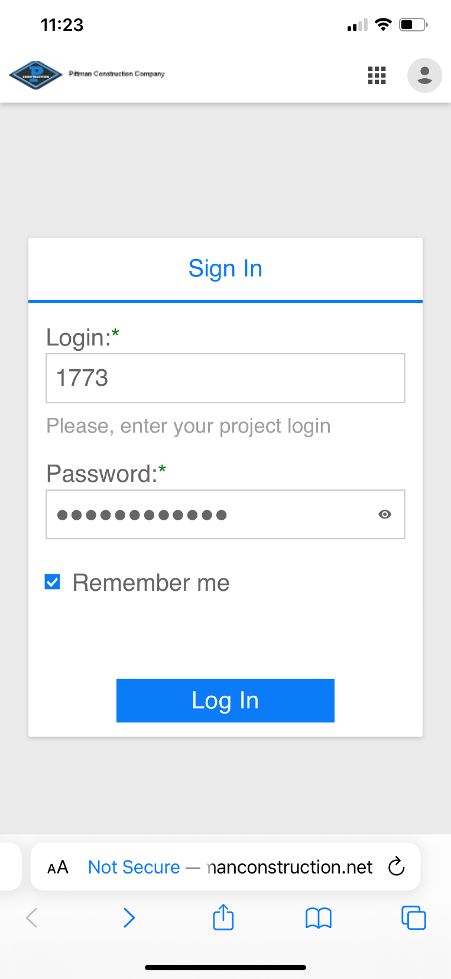
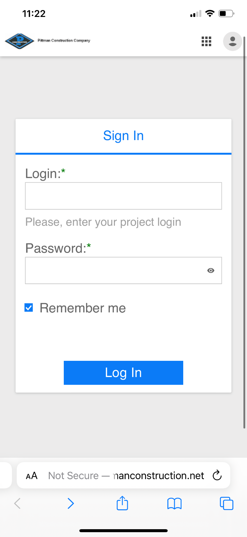
Mobile Application
First, Enter into Web browser or click hyperlink on phone https://eticketsmobilegps.pittmanconstruction.net
Then, Enter your Pittman login and Password Supplied by Pittman

Slide 3
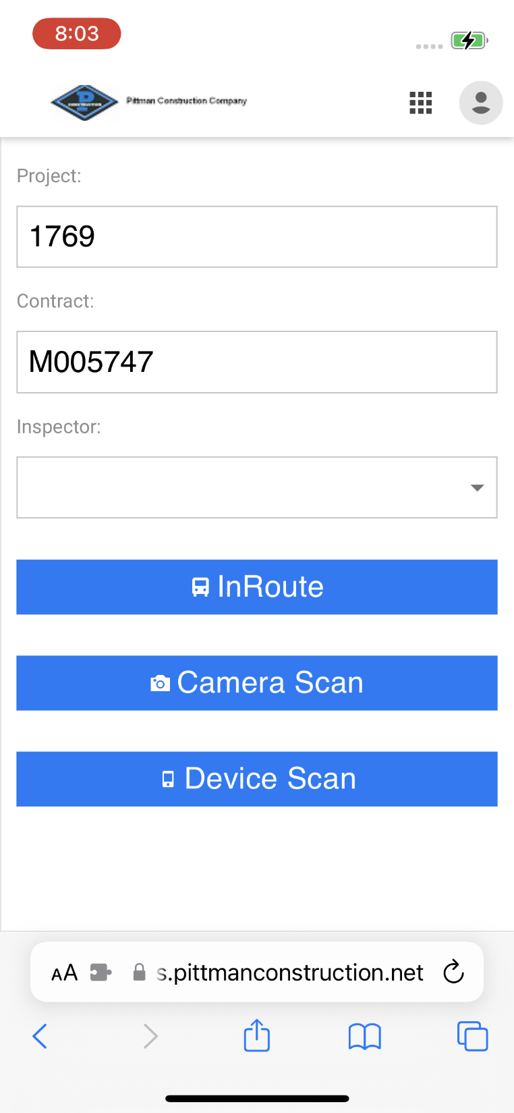
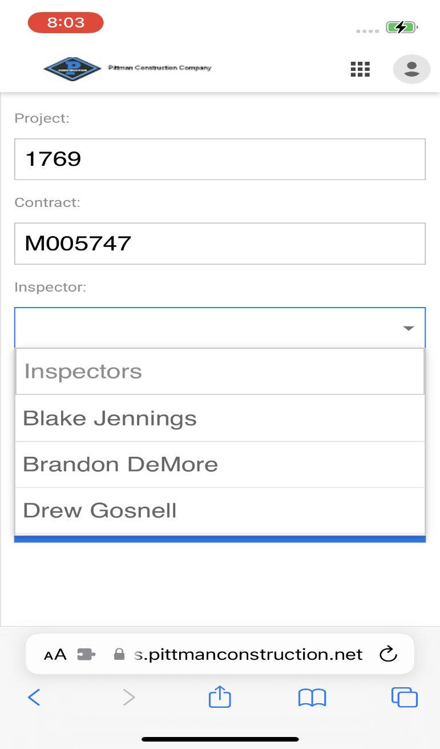
Mobile Application
Once signed in the inspector will find their name in the drop down bar labeled inspector. Press in- route mode to continue.

Slide 4
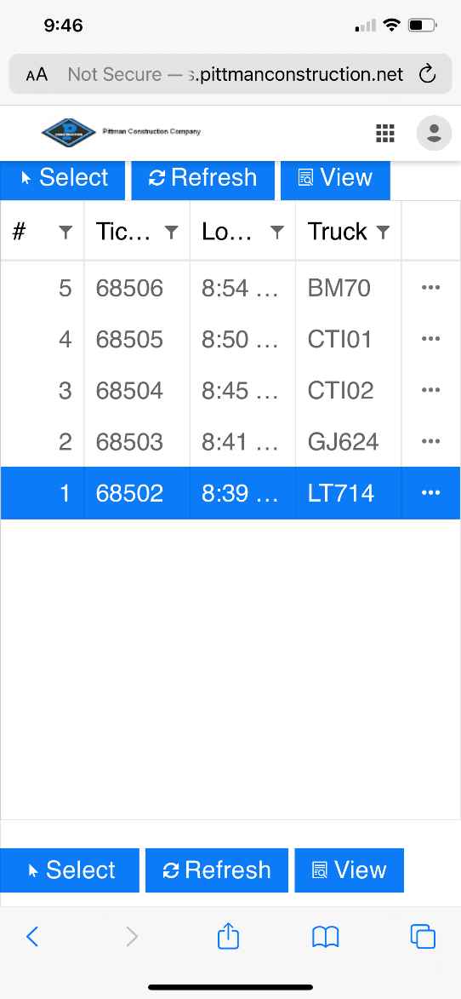
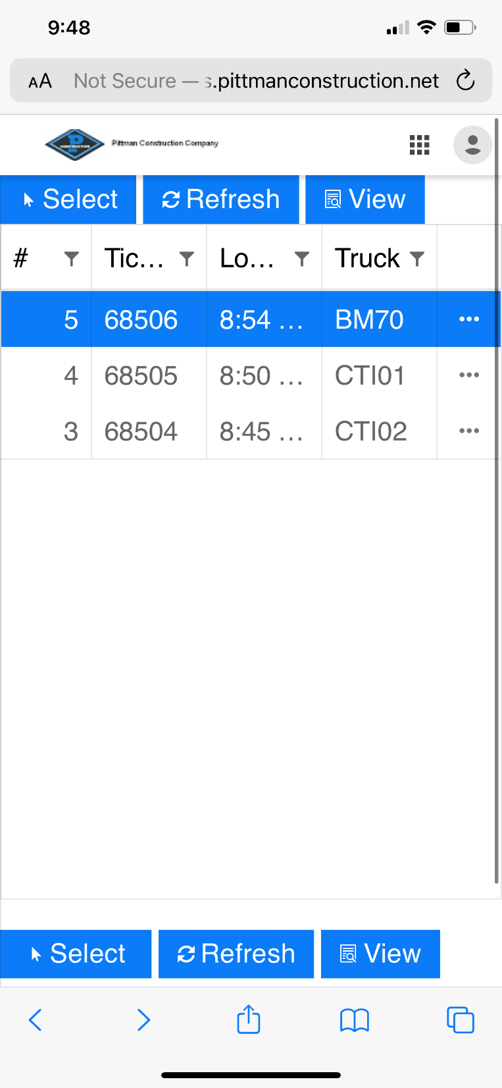
Selection list
Mobile Application
After, Highlighting the correct truck press the “select” button at the bottom of the screen
This will take you to the accept page and give the user options for temperature and accepting the ticket.

Slide 5
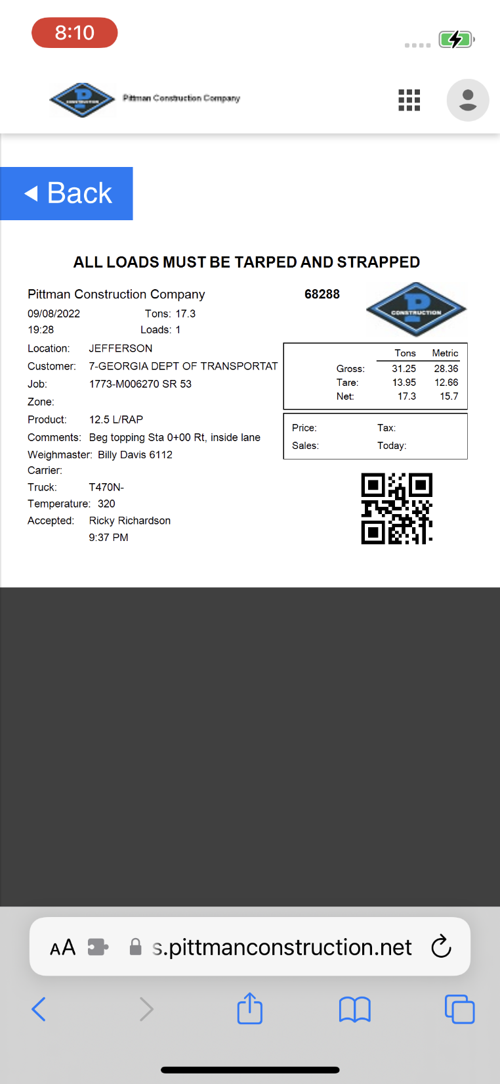
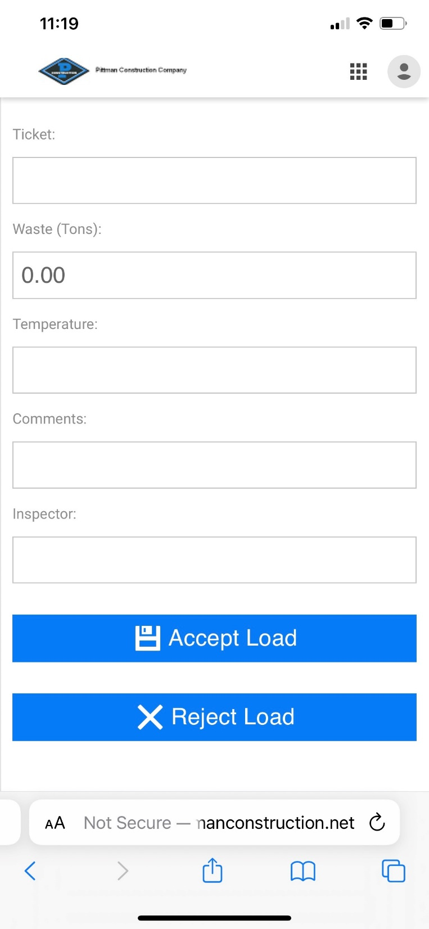
Mobile Application
After the ticket is accepted the ticket number will populate the field automatically. The other will need to be entered in manually(comments, temp and waste if any).
On the selection screen there is also an option to view the screen by choosing the view button.

Slide 6
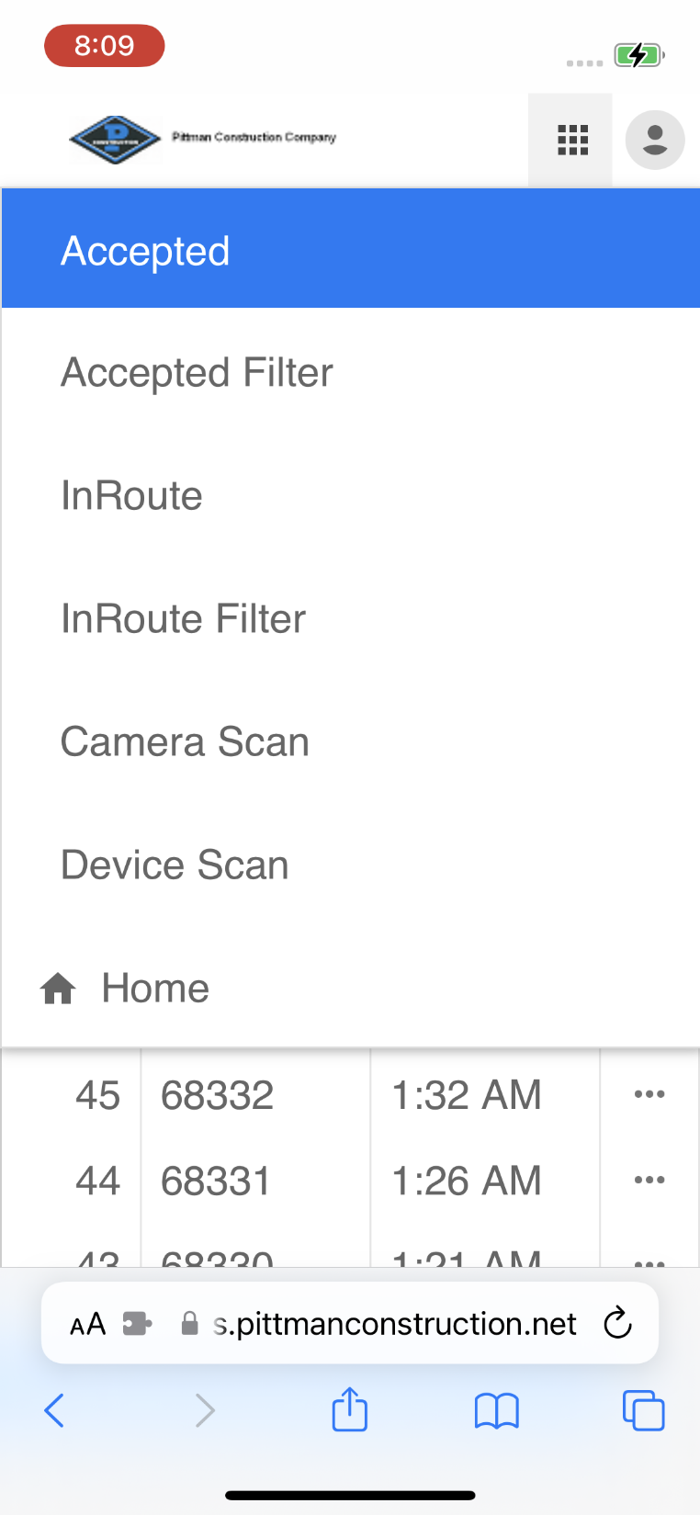
Mobile Application
The green arrow shows where the square icon is that presents your drop down menu.
The previous slide shows you how to properly fill out the E-ticket. Here you can see that you can both accept and reject from that page.
The blue arrow showing ‘Accepted‘will need more information when pressed.

Slide 7
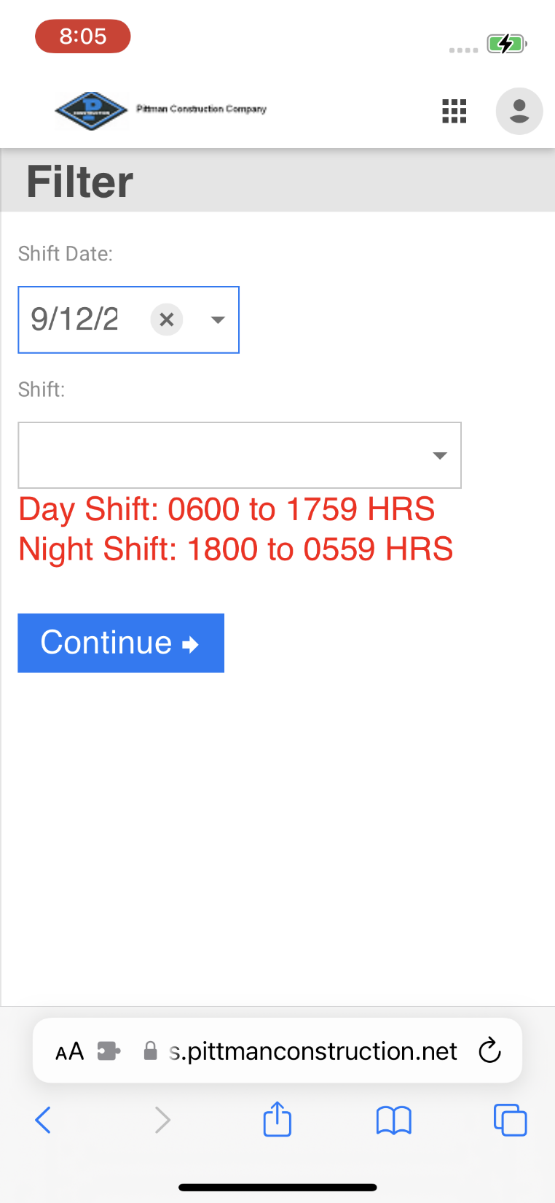
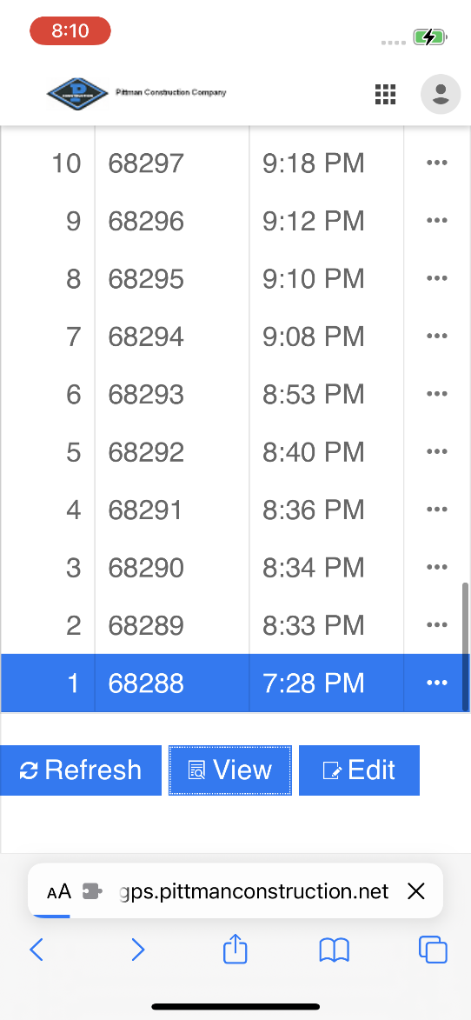
Accepted
Mobile Application
Once the date and shift are filled in correctly, you will be able to see accepted trucks for either option the user chose to accept the tickets.
Accepted Filter
Once the date and shift are filled in correctly, you will be able to see accepted trucks for either option the user chose to accept the tickets.

Slide 8
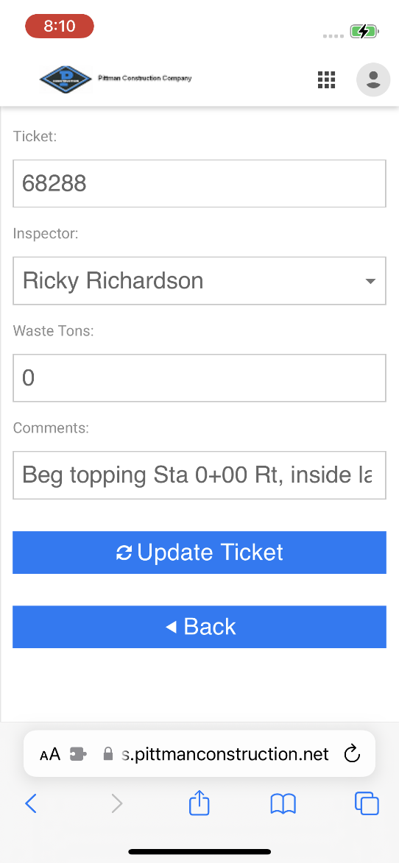
Mobile Application
On the Accepted screen there is also an option to view the screen by choosing the view button.
If you need to go back and change some of the previous information on tickets there is also an option on the accepted screen for Editing tickets

Slide 9

Contact us
Julius Montgomery
Layson Giles
Email: jmontgomery@pittman-construction.com
Phone (770)480-6272
Email: laysongiles@pittman-construction.com
Phone:(480)277-4530

